Slide 1
CONTAINERS AND DOCKER EXPRESS COURSE
Presented by :
Kaulitz Guimarães - Software developer at IBM

Slide 2
Agenda
Part I
( Concept content)
Part II
(Practical part)
Content :
Docker Context
Docker Infrastructure
Docker images
Docker containers
DockerHub

Slide 3
Kaulitz Guimarães
Student at Unicamp ( 8th semester) .
Software Developer at IBM ( Internal Compliance Services) - DevOps, automation, Kubernetes, Docker, API’s and Dashboard).
IBM parallel projects - AI-A-THON, Call for code, Passport, patents related to machine learning.

Slide 4
Why I learned Docker ?

Slide 5
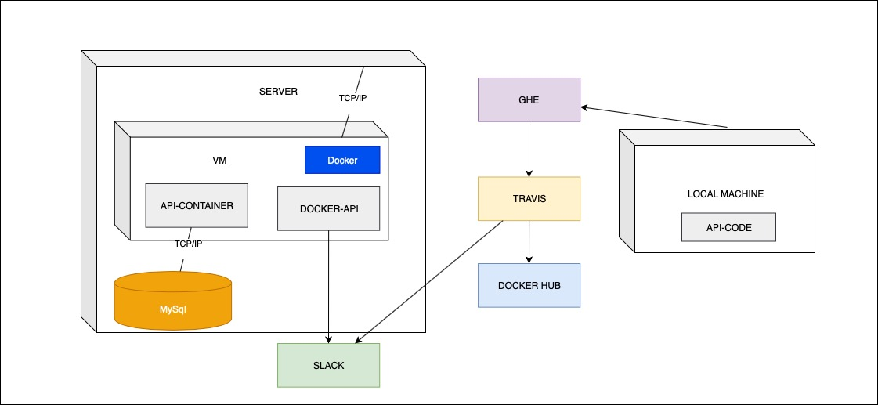
Passport Project

Slide 6
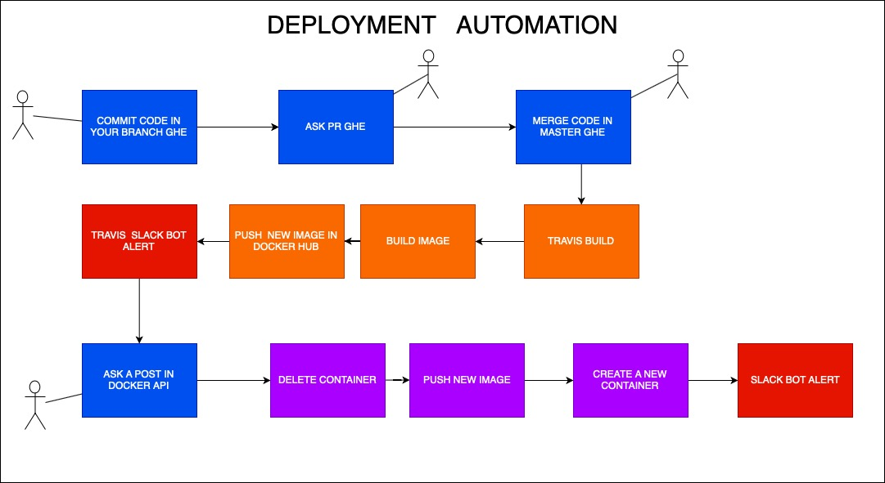
Passport Project

Slide 7
A developer issue ….
?
Notes:
Imagine that a developer, ad a freelancer, needs to deploy a bunch of applications, using a a same server.
Now he is working in a new application, that will use python, mysql, nginx and html.
His server has already 3 applications running, above his OS (Cent OS).
Now he will up more one application.
So he could face some issues like ..
He needs to use different technologies, different versions, etc ...

Slide 8
A developer issue ….
Client requirements :
Python 3.5 (backend)
Nginx ( frontend)
MYSQL 5.6 ( database)
APP 1
APP 2
APP 3
APP 4

Slide 9
A developer issue ….
ISSUES :
Install python and MySQL
Possible Issue : You need to use a different version of python that is installed in the server.
Install NGINX
Possible Issue : It can have conflict between your OS and the NGINX version that you are using.
This will cost a lot of time to developer solve it
Or not …

Slide 10
The developer solution ….

Slide 11
What is Docker ?
Historical Facts :
Docker start as a internal project in dotCloud company, as a PaaS.
It was released in 2013 as an open source Tool.
Docker is a container management software.
The main idea of docker is for developers to easily deploy their applications without worry with common infrastructure issues, as O.S version, current language version and the infrastructure dependencies itself .
Docker documentation : https://docs.docker.com

Slide 12
VMs vs Containers
Virtual machines : share same hardware, but they have they own kernel and is mounted by a default OS image (ISO), they are heavy and the need a lot of hardware usage.
Containers : share the same kernel, they have an OS as a base, but only with the necessary resources, which means they are lighter and scalable.

Slide 13
OS’s that support Docker

Slide 14
Where Can We Download Docker ?
Mac and Windows :
https://www.docker.com/products/docker-desktop
Linux Distribution :
https://runnable.com/docker/install-docker-on-linux

Slide 15
Docker Container
It is a “pack” with code and its dependencies runs quickly and reliably from one computing environment to another.
Containers isolate software from its environment and ensure that it works uniformly despite differences for instance between development and staging.

Slide 16
Docker advantages
Target Users : Developers
Docker reduces time configuring infrastructure as servers and VM’s to support the application.
Docker prevents that the server stays “dirty” due application dependencies.
You can deploy Docker containers anywhere, on any physical and virtual machines and even on the cloud.
Since Docker containers are pretty lightweight, they are very easily scalable.
Docker containers are made to be destroyed and created all the time, otherwise servers and VM’s.

Slide 17
Docker Infrastructure

Slide 18
Docker Container
SERVER
Python 3.2
Apache 2.2
MySQL 5.1
Container I
Container II
Container II
MySQL 5.6
Python 3.5
Nginx1.17.1
Notes:
He needs use python 3.5
nginx
mysql 5.4

Slide 19
DOCKER IMAGE!!!!!
How a container is created ?

Slide 20
Docker Image
Docker images are made by commands with a really simple syntax that will be use to build the containers, like a class that becomes an objects.
Each command in the image creates layer/digest. This way docker minimize processing cost when we update them.

Slide 21
Docker Image

Slide 22
Dockerfile
Dockerfiles contains the commands to build an image.
By pattern the first command is always FROM (image name). This command tells to docker that this image will be build above the one that you specified. You need at least an OS ( a Linux distribution) as a base image.

Slide 23
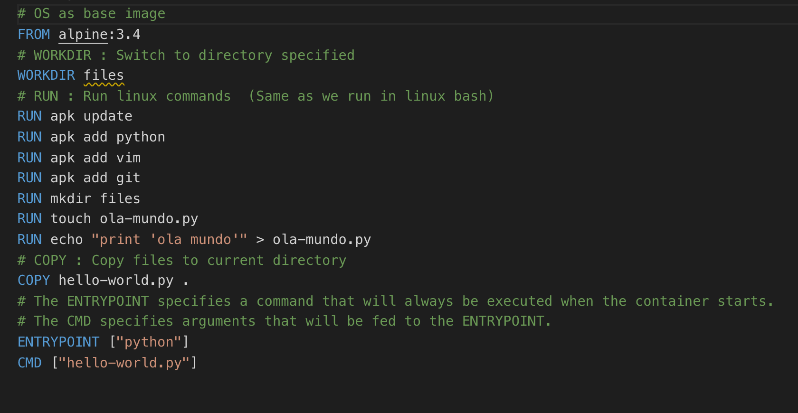
Dockerfile

Slide 24
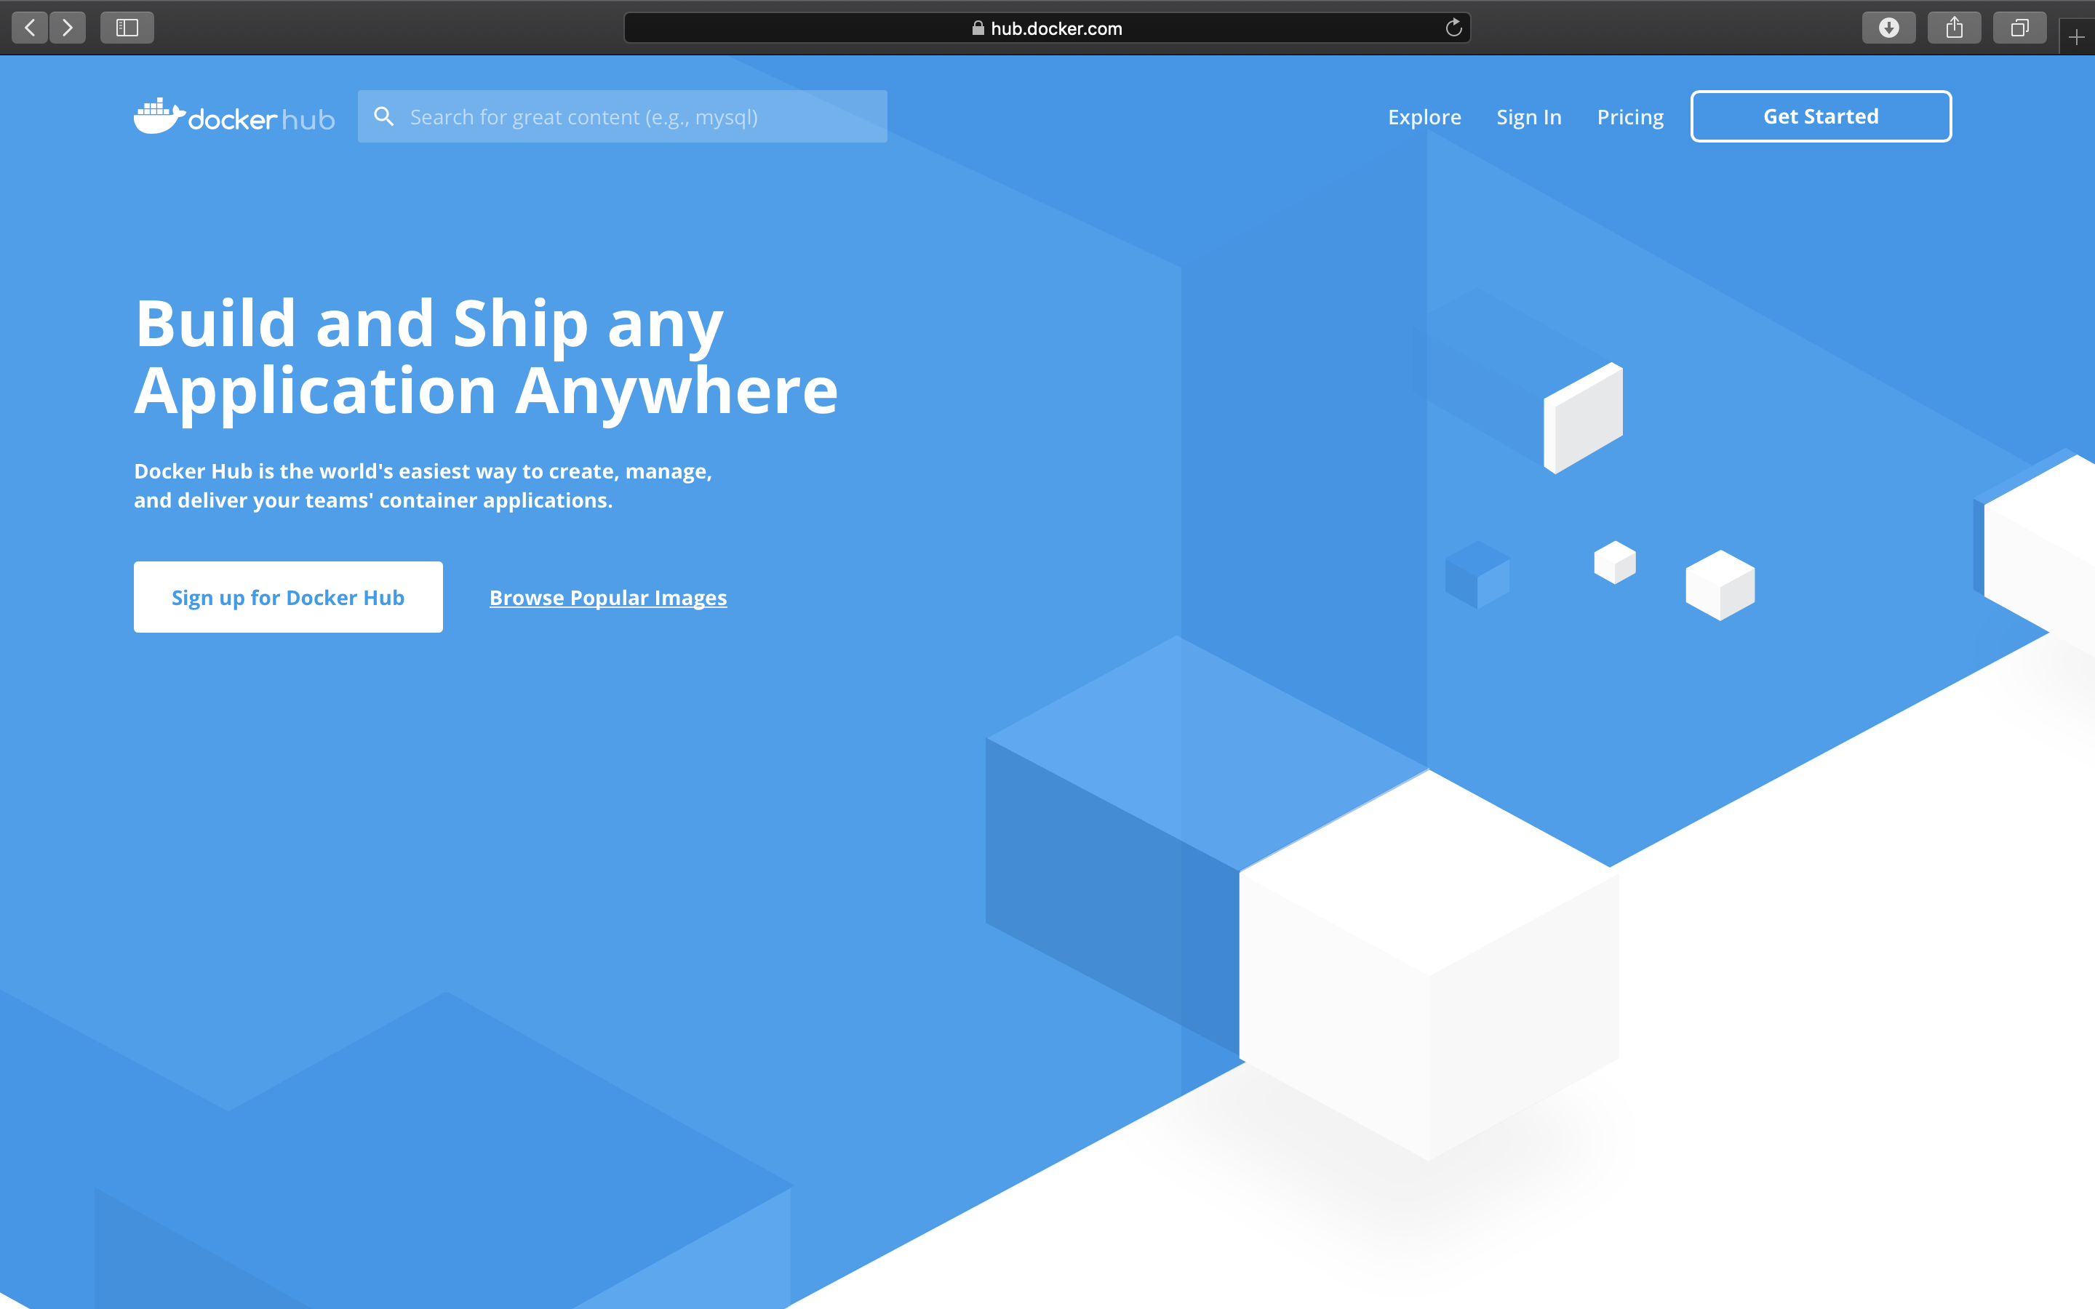
DockerHub

Slide 25
DockerHub
DockerHub is like a GitHub for containers.
There are official images that you can use directly or as a image base in your Dockerfile.
You can also upload your own image (public and one private as free).
https://hub.docker.com

Slide 26
Pause
See you in 10 min ☺

Slide 27
Docker in practice
Create an account in https://hub.docker.com
Access this link : https://labs.play-with-docker.com
Add an instance.

Slide 28
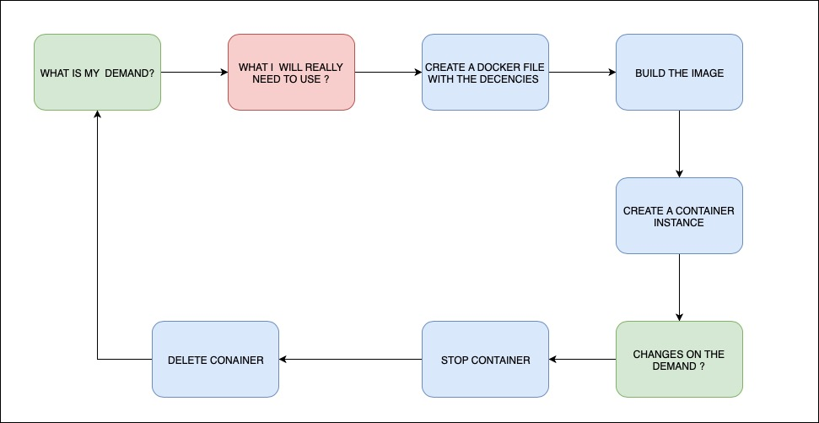
Docker in practice
Notes:
What’s your demand?
- A database
- A backend implementation (e.g., python, node, PHP, Java )
- A frontend implementation (e.g., HTML5,React, Angular)
- A environment to do testing

Slide 29
Docker in practice
How to pull an image with docker command :
docker pull (image-name)
How create a container by image name:
docker run --name (container-name) -it [-d] [-p] [portFromContainer:portToExpose] (image-name) --env [ENV variable]
How to build an image :
docker build -t (image_name) .
How to list containers/images
docker (image/container) ls
How to stop/start a container
docker start/stop (container-name or container-id)
How to delete a container/image
docker (image/container) rm (container-name/image-name)

Slide 30
Exercise I
1. Test docker creating an instance of hello-world image (not detached)
2. Delete container.
B)
1. Test docker creating an instance of hello-world image (detached)
2. Delete container.
1. docker pull hello-world / docker run -it --name my_first_container hello-world
2. docker stop my_first_container / docker container rm my_first_container
B)
1. docker pull hello-word / docker run -it --name my_first_container hello-word
2 . docker stop my_first_container / docker container rm my_first_container

Slide 31
Exercise II
Create a Dockerfile based on alpine OS, run the command “uname”.
Create a Dockerfile based on ubuntu OS, run the command “uname” .
A)
touch Dockerfile
vi Dockerfile
FROM alpine:latest
CMD [ "uname" ]
B)
touch Dockerfile
vi Dockerfile
FROM ubuntu:latest
CMD [ "uname" ]
Notes:
CREATE A FOLDER FOR EACH OS

Slide 32
Exercise II
C) Create an image based on alpine docker file.
D) Create an image based on ubuntu docker file.
C) Docker build -t my_alpine .
D) Docker build -t my_ubuntu .

Slide 33
Exercise II
E) Create an alpine container (not detached).
F) Create an ubuntu container (detached).
E) Docker run -it --name alpine_container my_alpine
F) Docker run -it -d --name ubuntu_container my_ ubuntu

Slide 34
Docker in practice
How to get in a container :
docker exec -it container-name or container-id) (command e.g., bash)
How to get a container log :
docker logs stop (container-name or container-id)

Slide 35
Exercise II
G) Catch ubuntu container log
H) Get into alpine container then run the command “cat /etc/os-release”
G) docker logs ubuntu_container
H)
Way I :
docker exec -it alpine_container bash
-> cat /etc/os-release
Way II :
docker exec -it alpine_container cat /etc/os-release

Slide 36
Exercise III
A) Choose one Dockerfile from exercise before, then add the uname command as an entry point. Then add a command with the flag “-r”.
B) Rebuild the image using same command as the exercise before.
A)
FROM ubuntu:latest
ENTRYPOINT [ "uname" ]
CMD [ "-r" ]
B)
Docker build -t my_ubuntu .

Slide 37
Exercise III
C) Delete the old container from exercise II.
D) Create a new container with same name as exercise II ( detached).
C)
docker stop ubuntu_container
docker container rm ubuntu_container
D)
docker run -it -d --name ubuntu_container my_ubuntu

Slide 38
Exercise III
E) Catch container logs
F) Delete the container
E)
docker logs ubuntu_container
F)
docker stop ubuntu_container
docker container rm ubuntu_container

Slide 39
Exercise III
G) Create another container with same name as before, but overriding the “-f” default flag by using the “-a” one (detached).
H) Catch ubuntu container log
G)
docker run -it -d --name ubuntu_container -a
H)
Docker logs ubuntu_container

Slide 40
Front-End with NGINX , HTML5, CSS3 and Js
Now we’ll deploy a web page, developed in HTML5, CSS3a and Js that shows the current Dollar price based on Real.
We will use Docker container along with NGINX to do that
NGINX is a HTTP server, like APACHE.
We’ll use it to deploy a HTML webpage.

Slide 41
Exercise IV
A) Create a NGINX container
A)
docker pull nginx:1.17 / docker run -it -d --name ngnixContainer -p 8080:80 nginx:1.17

Slide 42
Exercise V
A)
Run this command on your bash :
git clone https://github.com/KaulitzGuimaraes/DockerCourse
C)
FROM nginx:1.17
VOLUME dollarprice
COPY . / dollarprice
WORKDIR dollarprice
COPY . /usr/share/nginx/html
EXPOSE 80
B) Go to the Dollar Price folder by running the command
cd DockerCourse/PraticalExercises/DollarPrice
C)
Create a Dockerfile, then :
Create a new direct called dollarprice
Copy the current code into the folder
Switch to this directory
Move the current content to this path /usr/share/nginx/html
Expose port 80

Slide 43
Exercise V
D)
Build the image with the name dollarprice
E)
Create a container with the name dollarprice_container and port 8080
D)
docker build -t dollarprice .
E)
docker run -it -d --name dollarprice_container -p 8080:80 dollarprice

Slide 44
Exercise V
F)
Delete the container
G)
Update the application code by running the command
git pull
Rebuild the image
Create another container with same name and port
F)
docker stop dollarprice
docker container rm dollarprice
H)
docker build -t dollarprice .
I)
docker run -it -d --name dollarprice_container -p 8080:80 dollarprice

Slide 45
Exercise VI
A)
Download the code from GitHub link in your machine. Unzip it and open in a editor, you can use a local one or download sublime.
GitHub : https://github.com/KaulitzGuimaraes/DockerCourse
Sublime (Windows only) : https://www.sublimetext.com/3
B) Now change the application appearance , you can change the HTML and the CSS. In case you feel comfortable to change the Js code, you can also switch the coins conversion.
API documentation : https://exchangeratesapi.io

Slide 46
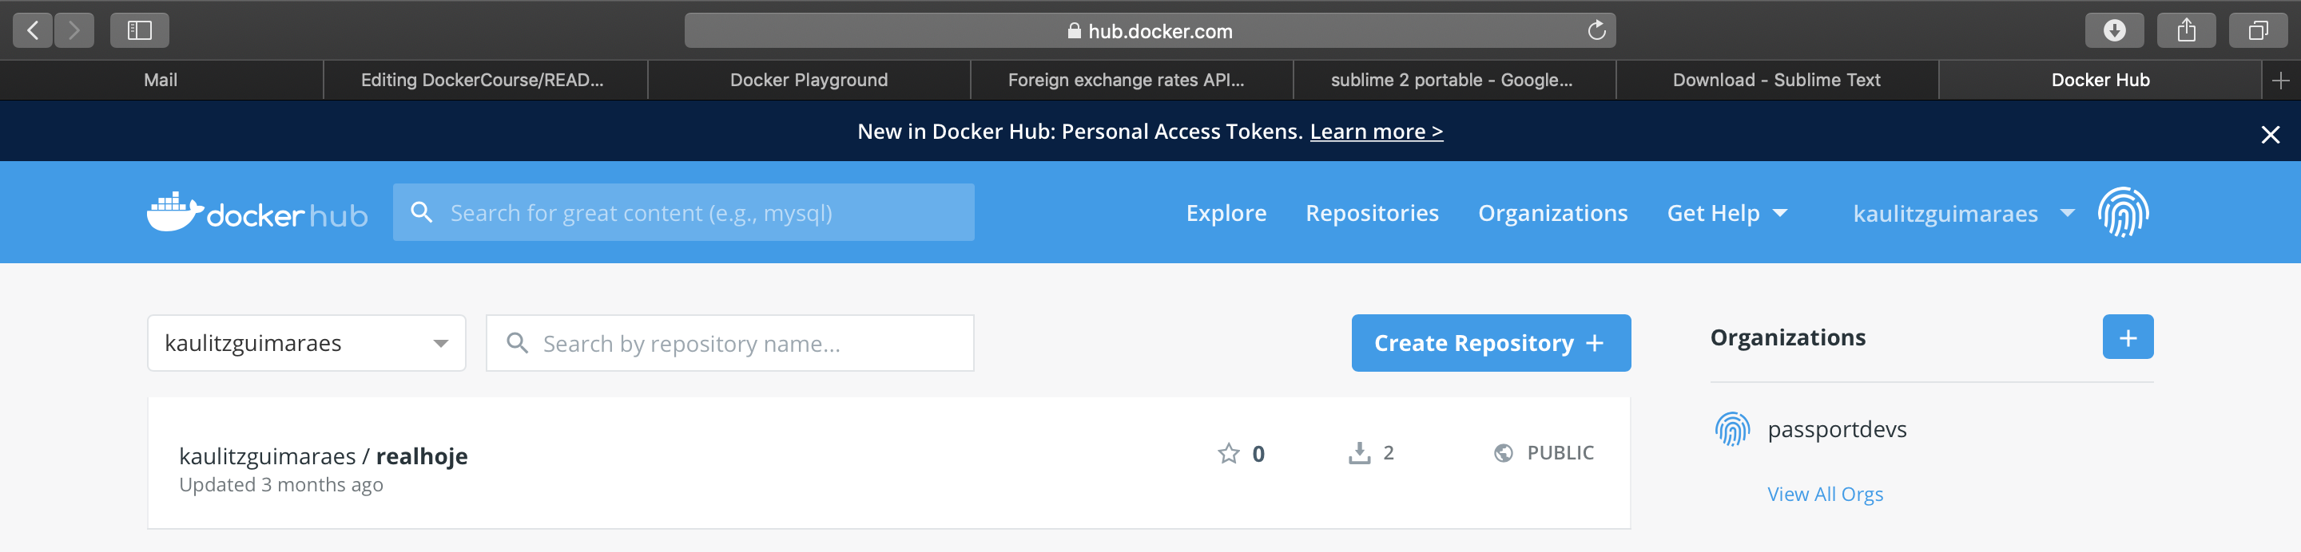
Exercise V
C)
Copy the content for each file that you have changed in the docker player .
D)
Now open your dockerhub account accessing the link below :
https://hub.docker.com
Check your name profile :

Slide 47
Docker in practice
Login with docker account
docker login
Upload an image at docker hub
docker push (imagename)
P.S. : Your image name MUST follow this pattern : “your_usrname”/image_name

Slide 48
Exercise VI
C)
Build the a new image with the same Dockerfile, but using “your_user”/dollarprice as the image name
D)
Login with your DockerHub login
E)
Push your image to DockerHub repository
F) Reload your DockerHub page , check if your image is there.
C)
docker build -t “your_user”/dollarprice .
D)
docker login
E)
docker push “your_user”/dollarprice

Slide 49
Exercise VI
F)
Add a new instance in your docker playground .
G)
Check the images available.
H)
Push your image from DockerHub to your local machine.
I) Create a container with your username and port 80.
G)
docker image ls
H)
docker pull “your_user”/dollarprice
I)
docker run -it -d --name “your_user” -p 80:80 “your_user”/dollarprice

Slide 50
MYSQL in Container
Instead of waist time installing databases locally, you can just create a container with a MySQL image by one command, then you can delete whenever you want just removing the container.

Slide 51
Exercise VII
Pull the MySQL version 5.6 image
Create a container called mysql52 with the following parameters :
"MYSQL_ROOT_PASSWORD=123456"
Get in the container called mysql-server by using the follow command :
mysql -p
Run the command , inside of the container :
show databases;
docker pull mysql:5.6
B) docker run -it -d --env MYSQL_ROOT_PASSWORD=123456 -p 3306:3306 --name mysql-server mysql:5.6
docker exec -it mysql-server mysql -p
D) -> show databases;

Slide 52
MYSQL in Container
What if I have a local database and I want to switch to a container ?

Slide 53
Exercise VIII
Go the the mysql_ex folder.
Create a new Dockerfile based on the latest image from mysql, and then add a command to copy the “d.sql” file to the image current directory.
Build the image with the name mysql-server and create a new container with name mysql_container .
B)
FROM mysql:latest
COPY d.sql .
C) docker build -t mysql_content .
docker run -it -d --name mysql-server --env "MYSQL_ROOT_PASSWORD=123456” -p 3306:3306 mysql_content

Slide 54
Exercise VIII
Get into the container bash, then run the following command :
mysql -u root -p < d.sql
E) Execute the command “show databases;”
D)
docker exec -it mysql_content bash
-> mysql -u root -p < d.sql
E)
-> mysql -p
-> show databases;

Slide 55
A full Application with Docker
?

Slide 56
Some tips
Docker Essentials (cognitiveclass.ai) :
https://cognitiveclass.ai/courses/docker-essentials
Technologies that you MUST have to know :
API ( NodeJs , Python, Java)
Free Ebook - An Introduction to APIs : (https://www.amazon.com/gp/product/B01MYOBVUA?pf_rd_p=2d1ab404-3b11-4c97-b3db-48081e145e35&pf_rd_r=1DZ3YEXC8KR75D1WK7C3)
Github
React/Angular
Docker/Kubernetes
https://www.udemy.com/course/certified-kubernetes-application-developer

Slide 57
Conclusion
What is a container
Why use Docker
How do I containerize my applications

Slide 58
THANK YOU !!!!!
E-mail :
kaulitzguimaraes@hotmail.com
GitHub :
KaulitzGuimaraes

